Slide 1
Practical Introduction to the MMPI-2-RF
David M. McCord
Western Carolina University
mccord@wcu.edu
Find materials at:
http://paws.wcu.edu/mccord

Slide 2
Agenda
Overview 9:00-9:15
Background 9:15-9:20
Development 9:20-9:30
Scales 9:30-10:15
Break 10:15-10:30
Administration and Scoring 10:30-10:45
Interpretation 10:45-11:15
Cases 11:15-12:00

Slide 3
MMPI-2-RF Overview
Published 2008
Authors Ben-Porath & Tellegen
338 items
Subset of MMPI-2 Item Pool
Norms based on MMPI-2 normative sample
240+ peer-reviewed publications
Used widely in mental health, medical, forensic and public safety settings

Slide 4
MMPI-2-RF Overview
Overall Objective: Represent the clinically significant substance of the MMPI-2 item pool with a comprehensive set of psychometrically adequate measures:
Improve efficiency
Enhance construct validity
Overall Strategy:
First restructure the Clinical Scales (resulting in the Restructured Clinical [RC] Scales)
Then augment the RC Scales with needed additional measures

Slide 5
MMPI-2-RF Overview
51 Scales
9 Validity Scales
3 Higher-Order Scales
9 RC Scales
23 Specific Problems Scales
5 Somatic/Cognitive
9 Internalizing
4 Externalizing
5 Interpersonal
2 Interest Scales
5 PSY-5 Scales

Slide 6
Background

Slide 7
Background
Clinical Scales developed by Hathaway and McKinley in late 1930s early 1940s
Intended to function as a differential diagnostic test
Targeted Kraepelinian nosology
Published 1943
Didn’t work as intended

Slide 8
Background
Psychometric Challenges
Excessive correlations
Item Overlap
Heterogeneity
Ad hoc solutions
Code Types
Subscales
Supplementary Scales
Challenges Not addressed with MMPI-2

Slide 9
Development

Slide 10
Development
Factor analyses of targeted item sets to:
Identify and remove (to the extent needed and feasible) a common factor - Demoralization
Identify Major Distinctive Core Components
Targeted item sets include:
Clinical Scales
Content Scales
Select Subscales
Supplementary Scales
Various “experimental” scales

Slide 11
Development
Correlational analyses augment Seed Scales with items contributing to convergent and discriminant patterns
Scales retained IF show evidence of convergent and discriminant validity
Linked to current models and conceptualizations of personality and psychopathology

Slide 12
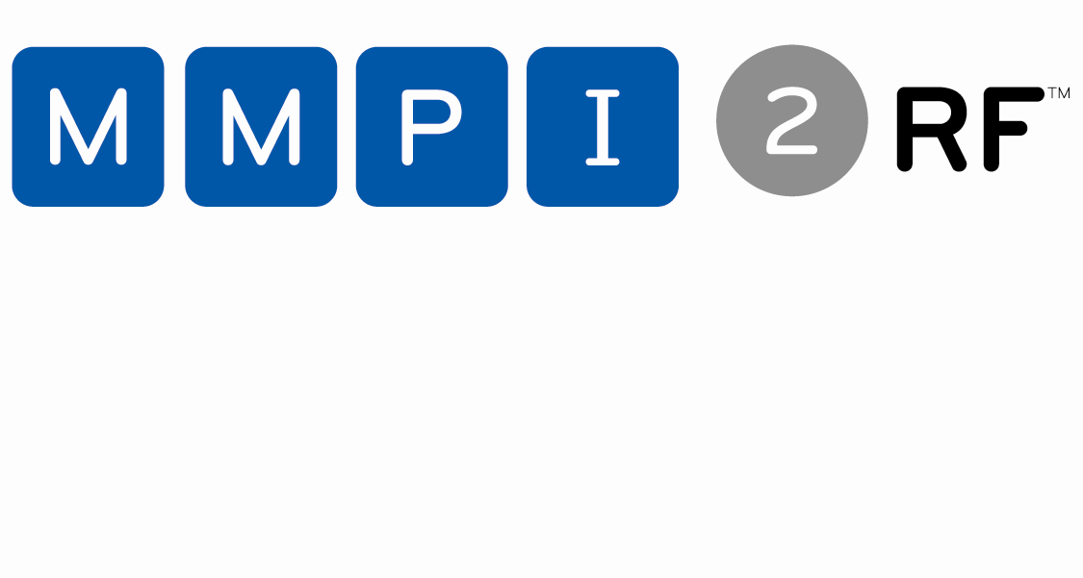

Slide 13
MMPI-2-RF Scales

Slide 14
MMPI-2-RF: Validity Scales
VRIN-r: Variable Response Inconsistency – Random responding
TRIN-r: True Response Inconsistency – Fixed responding
F-r: Infrequent Responses – Responses infrequent in the general population
Fp-r: Infrequent Psychopathology Responses – Responses infrequent in psychiatric populations
Fs: Infrequent Somatic Responses – Somatic complaints infrequent in medical patient populations
FBS-r: Symptom Validity – Somatic and cognitive complaints associated at high levels with over-reporting
RBS: Response Bias Scale - Exaggerated memory complaints
L-r: Uncommon Virtues – Rarely claimed moral attributes or activities
K-r: Adjustment Validity – Avowals of good psychological adjustment associated at high levels with under-reporting

Slide 15
MMPI-2-RF: Higher-Order Scales
EID – Emotional/Internalizing Dysfunction – Problems associated with mood and affect
THD – Thought Dysfunction – Problems associated with disordered thinking
BXD – Behavioral/Externalizing Dysfunction – Problems associated with under-controlled behavior

Slide 16
MMPI-2-RF: RC Scales
Identical to MMPI-2 RC Scales
RCd: Demoralization – General unhappiness and dissatisfaction
RC1: Somatic Complaints – Diffuse physical health complaints
RC2: Low Positive Emotions – Lack of positive emotional responsiveness
RC3: Cynicism – Non-self-referential beliefs expressing distrust and a generally low opinion of others
RC4: Antisocial Behavior – Rule breaking and irresponsible behavior

Slide 17
MMPI-2-RF: RC Scales
RC6: Ideas of Persecution – Self-referential beliefs that others pose a threat
RC7: Dysfunctional Negative Emotions – Maladaptive anxiety, anger, irritability
RC8: Aberrant Experiences -- Unusual perceptions or thoughts
RC9: Hypomanic Activation – Over-Activation, aggression, impulsivity, and grandiosity

Slide 18
MMPI-2-RF: Specific Problems (SP) Scales
Somatic/Cognitive
MLS: Malaise – Overall sense of physical debilitation, poor health
GIC: Gastrointestinal Complaints – Nausea, recurring upset stomach, and poor appetite
HPC: Head Pain Complaints – Head and neck pain
NUC: Neurological Complaints – Dizziness, weakness, paralysis, loss of balance, etc.
COG: Cognitive Complaints – Memory problems, difficulties concentrating

Slide 19
MMPI-2-RF: Specific Problems (SP) Scales
Internalizing (RCd Facets):
SUI: Suicidal/Death Ideation – Direct reports of suicidal ideation and recent attempts
HLP: Helplessness/Hopelessness – Belief that goals cannot be reached or problems solved
SFD: Self-Doubt -- Lack of self-confidence, feelings of uselessness
NFC: Inefficacy – Belief that one is indecisive and inefficacious

Slide 20
MMPI-2-RF: Specific Problems (SP) Scales
Internalizing (RC7 Facets):
STW: Stress/Worry -- Preoccupation with disappointments, difficulty with time pressure
AXY: Anxiety – Pervasive anxiety, frights, frequent nightmares
ANP: Anger Proneness -- Becoming easily angered, impatient with others
BRF: Behavior-Restricting Fears -- Fears that significantly inhibit normal behavior
MSF: Multiple Specific Fears -- Fears of blood, fire, thunder, etc.

Slide 21
MMPI-2-RF: Specific Problems (SP) Scales
Externalizing: RC4 Facets
JCP: Juvenile Conduct Problems – Difficulties at school and at home, stealing
SUB: Substance Abuse – Current and past misuse of alcohol and drugs
RC9 Facets
AGG: Aggression – Physically aggressive, violent behavior
ACT: Activation – Heightened excitation and energy level

Slide 22
MMPI-2-RF: Specific Problems (SP) Scales
Interpersonal:
FML: Family Problems – Conflictual family relationships
IPP: Interpersonal Passivity – Being unassertive and submissive
SAV: Social Avoidance – Avoiding or not enjoying social events
SHY: Shyness – Bashful, prone to feel inhibited and anxious around others
DSF: Disaffiliativeness – Disliking people and being around them

Slide 23
MMPI-2-RF: Interest Scales
AES: Aesthetic-Literary Interests – Literature, music, the theater
MEC: Mechanical-Physical Interests – Fixing and building things, the outdoors, sports

Slide 24
MMPI-2-RF: PSY-5 Scales
Revised versions of dimensional model of personality pathology developed by Allan Harkness and John McNulty:
AGGR-r: Aggressiveness-Revised – Instrumental, goal-directed aggression
PSYC-r: Psychoticism-Revised – Disconnection from reality
DISC-r: Disconstraint-Revised – Under-controlled behavior
NEGE-r: Negative Emotionality/Neuroticism-Revised – Anxiety, insecurity, worry, and fear
INTR-r: Introversion/Low Positive Emotionality-Revised – Social disengagement and anhedonia

Slide 25
Administering and Scoring the MMPI-2-RF

Slide 26
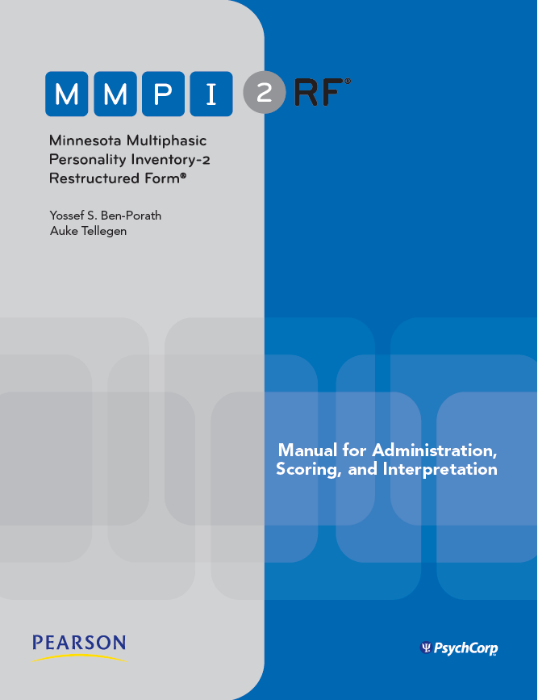

Slide 27
Administering and Scoring the MMPI-2-RF
Standard Procedures delineated in Manual for Administration, Scoring, and Interpretation
Administration:
Before Testing
Consider age
Inquire about prior testing experience
Assess Testability
Cognitive wherewithal
Vision
Reading Level: Grade 4.5 (Flesch Kincaid) 6 (Lexile)
Use Standard Administration Modalities
Booklet and answer sheet
Computer

Slide 28
Administering and Scoring the MMPI-2-RF
Scoring:
Normative Sample:
MMPI-2 Normative Sample Collected in 1980s
Non-gendered norms (1,138 men, 1,138 women)
Norms appear to be holding up well (Technical Manual Appendix C)

Slide 29
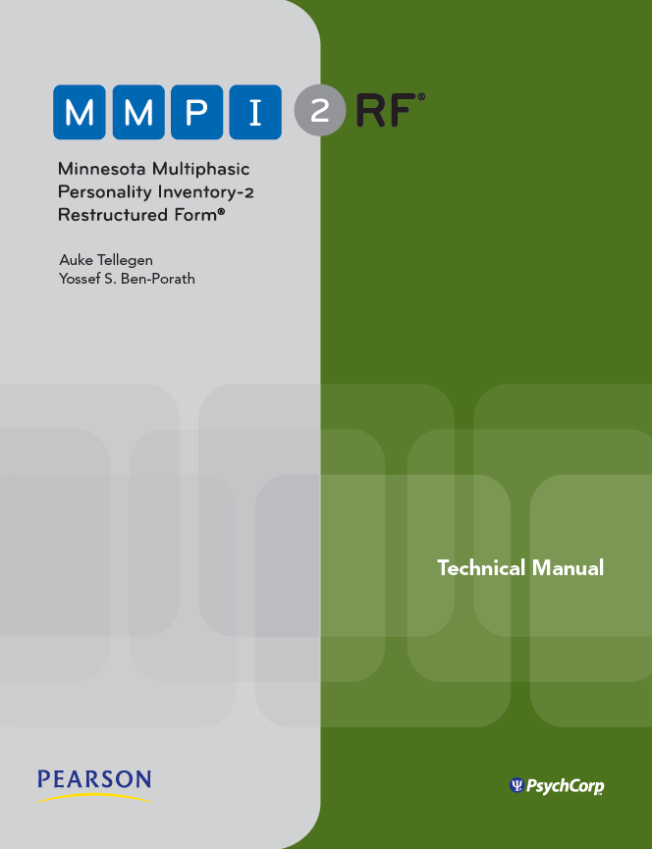

Slide 30
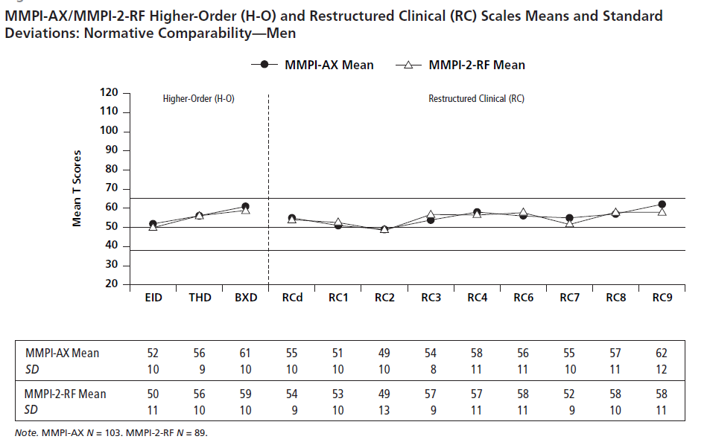

Slide 31
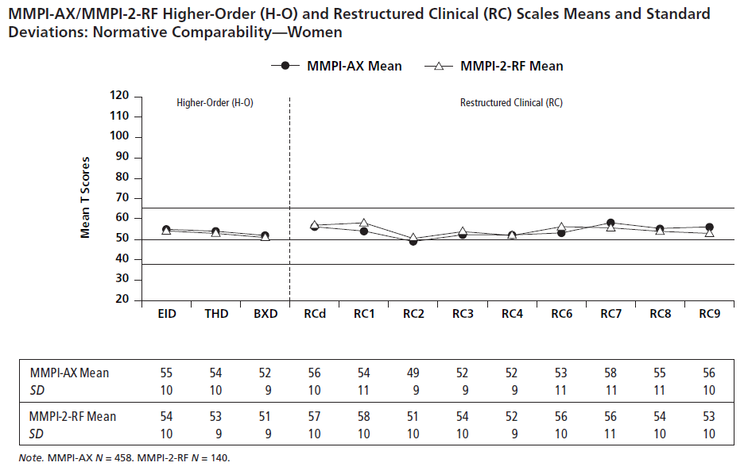

Slide 32
Administering and Scoring the MMPI-2-RF
Scoring:
Normative Sample:
MMPI-2 Normative Sample Collected in 1980s
Non-gendered norms (1,138 men, 1,138 women)
Norms appear to be holding up well (Technical Manual Appendix C)
Uniform T scores

Slide 33
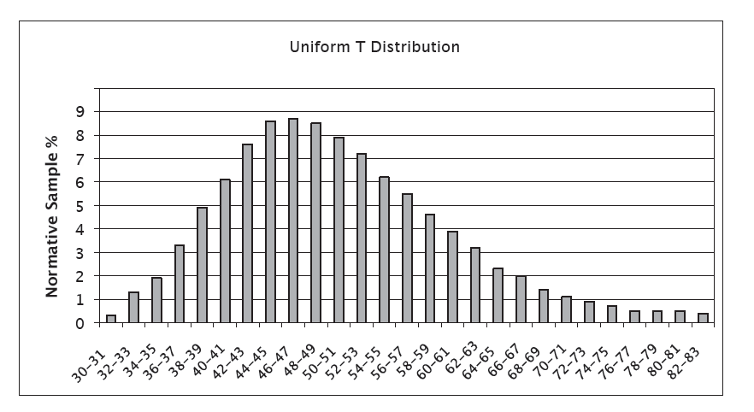

Slide 34
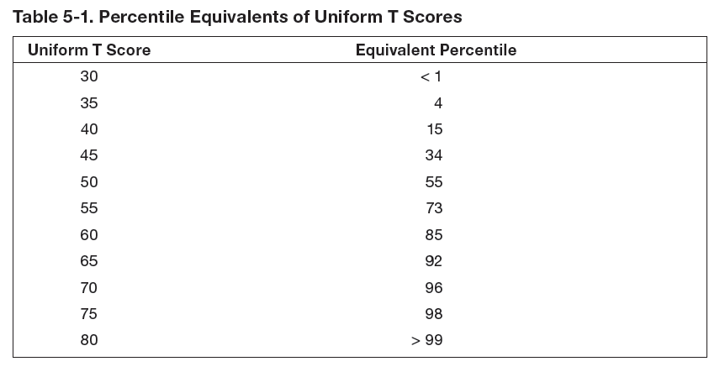

Slide 35
Administering and Scoring the MMPI-2-RF
Scoring:
Normative Sample:
MMPI-2 Normative Sample Collected in 1980s
Non-gendered norms (1,138 men, 1,138 women)
Norms appear to be holding up well (Technical Manual Appendix C)
Uniform T scores
Comparison Groups
Technical Manual Appendix D

Slide 36
MMPI-2-RF: Standard Comparison Groups
MMPI-2-RF Normative (Men & Women)
Outpatient, Community Mental Health Center (Men & Women)
Outpatient, Independent Practice (Men & Women)
Psychiatric Inpatient, Community Hospital (Men & Women)
Psychiatric Inpatient, VA Hospital (Men)
Substance Abuse Treatment, VA (Men)
Bariatric Surgery Candidate (Men & Women)
Spine Surgery/Spinal Cord Stimulator Candidates (Men & Women)
Chronic Pain (Men & Women)
College Counseling Clinic (Men & Women)
College Student (Men & Women)
Forensic, Disability Claimant (Men & Women)
Forensic, Independent Neuropsychological Examination (Men & Women)
Forensic, Pre-trial Criminal (Men & Women)
Forensic, Child Custody (Men & Women)
Forensic, Parental Fitness Evaluees (Men & Women)
Prison Inmate (Men & Women)
Personnel Screening, Law Enforcement (Men, Women & Combined)
Personnel Screening, Corrections Officer (Men, Women & Combined)
Personnel Screening, Clergy Candidates (Men, Women, & Combined)

Slide 37
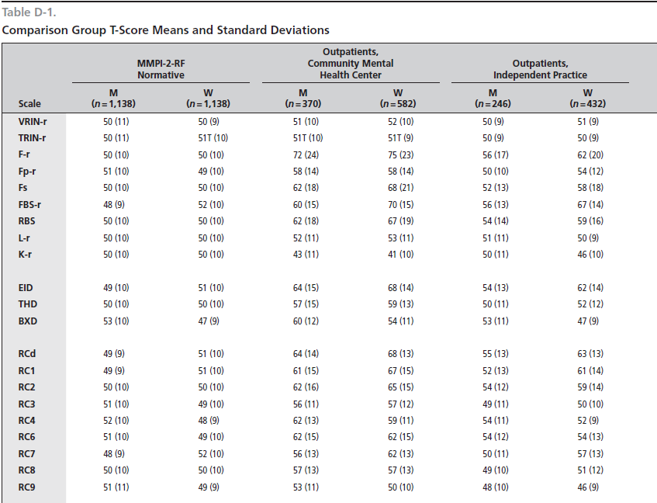

Slide 38
Administering and Scoring the MMPI-2-RF
Scoring:
Normative Sample:
MMPI-2 Normative Sample Collected in 1980s
Non-gendered norms (1,138 men, 1,138 women)
Norms appear to be holding up well (Technical Manual Appendix C)
Uniform T scores
Comparison Groups
Technical Manual Appendix D
Embedded in scoring software

Slide 39
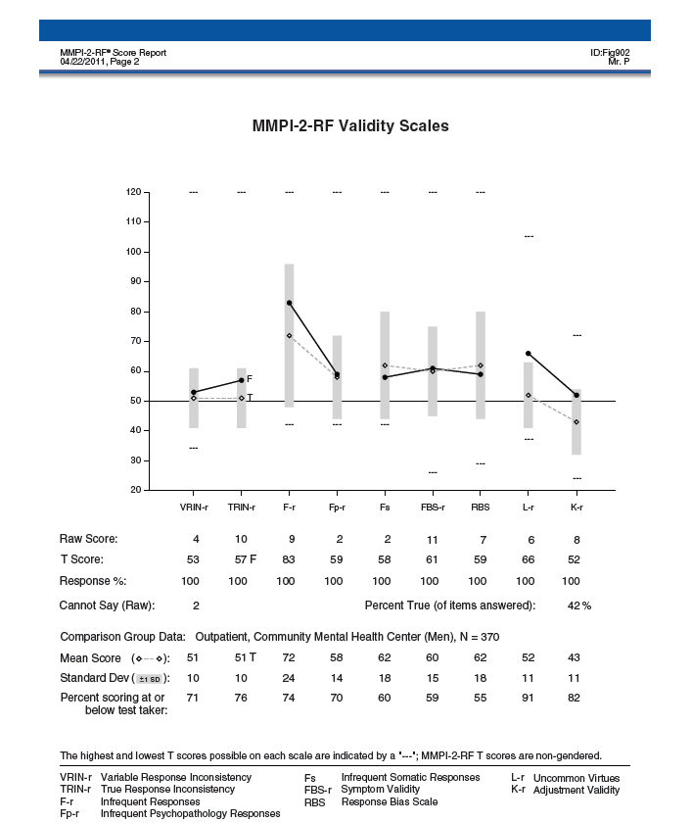

Slide 40
Administering and Scoring the MMPI-2-RF
Scoring:
Normative Sample:
MMPI-2 Normative Sample Collected in 1980s
Non-gendered norms (1,138 men, 1,138 women)
Norms appear to be holding up well (Technical Manual Appendix C)
Uniform T scores
Comparison Groups
Technical Manual Appendix D
Embedded in scoring software
Updated Periodically

Slide 41
Administering and Scoring the MMPI-2-RF
Scoring:
Standard Scoring Modalities:
Hand scoring
Computer (Q Local or Q Global)
Score Report (Described in User’s Guide for Report)

Slide 42
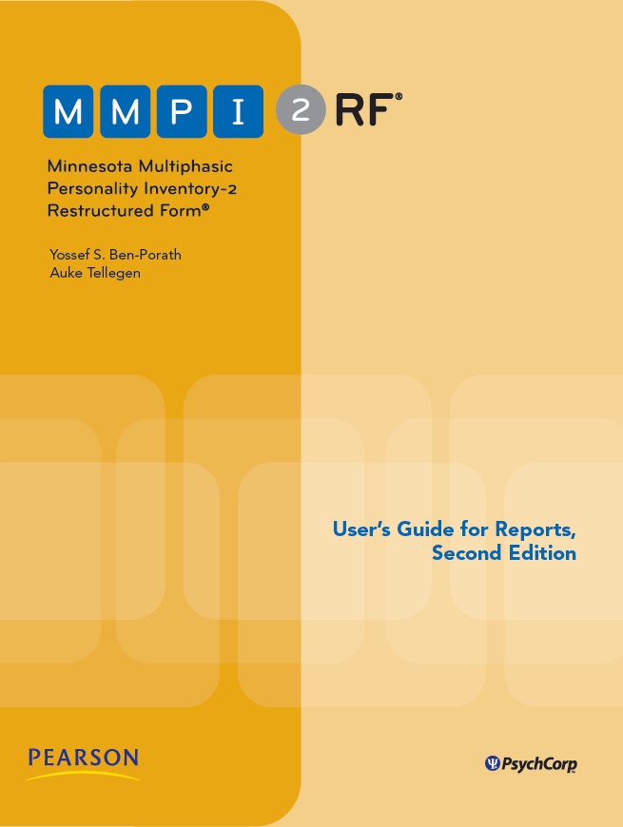

Slide 43
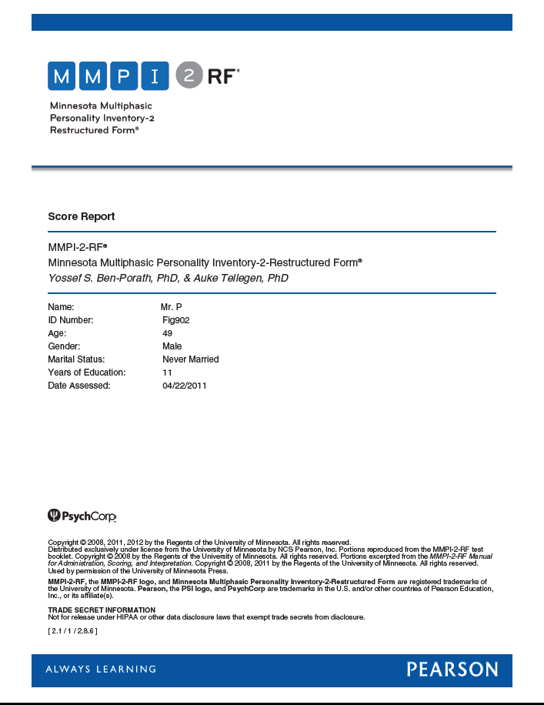

Slide 44
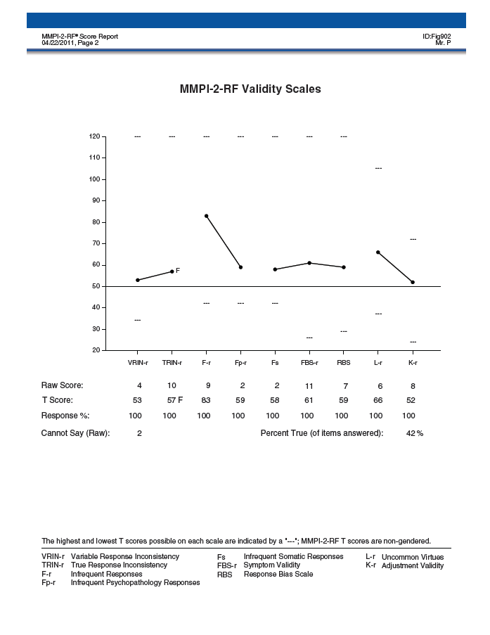

Slide 45
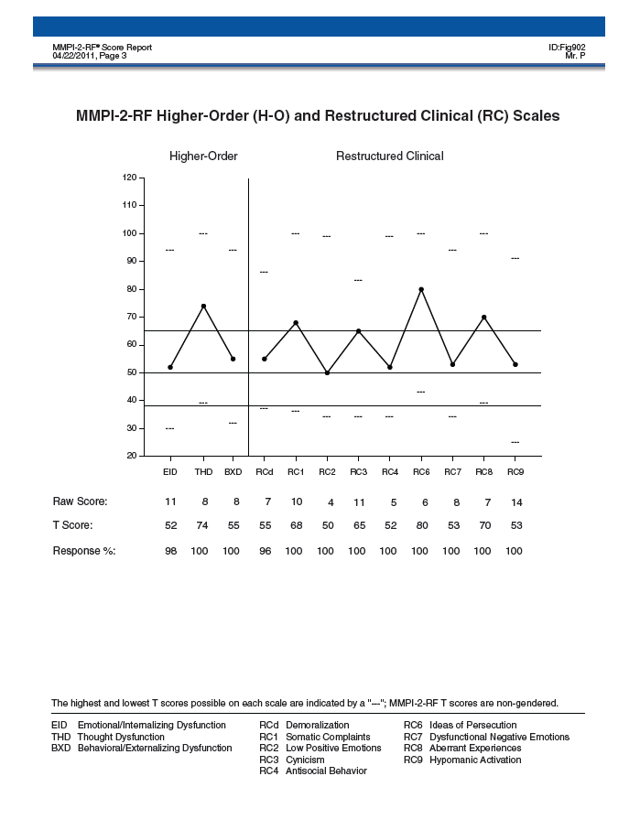

Slide 46
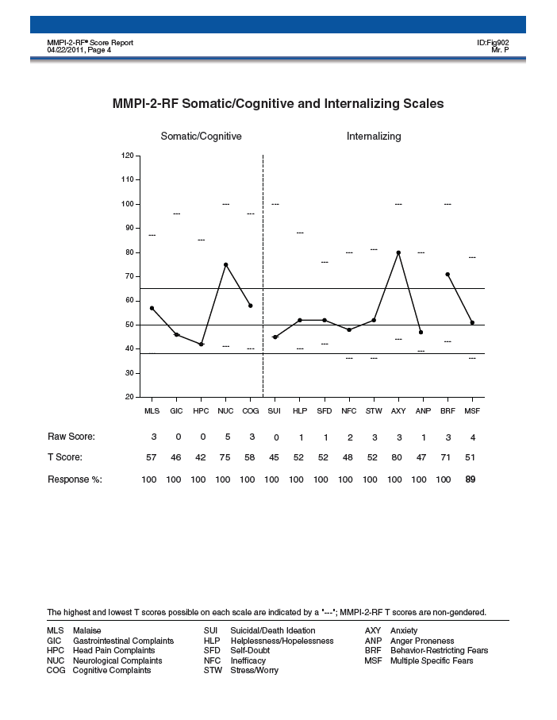

Slide 47
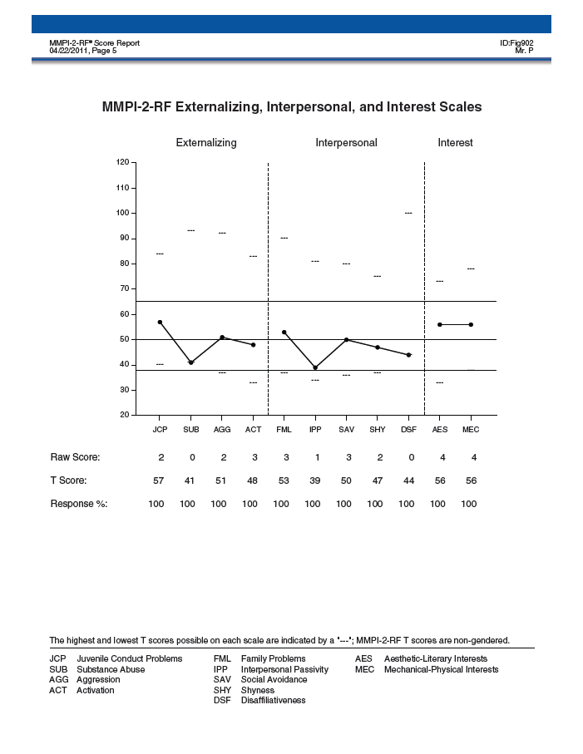

Slide 48
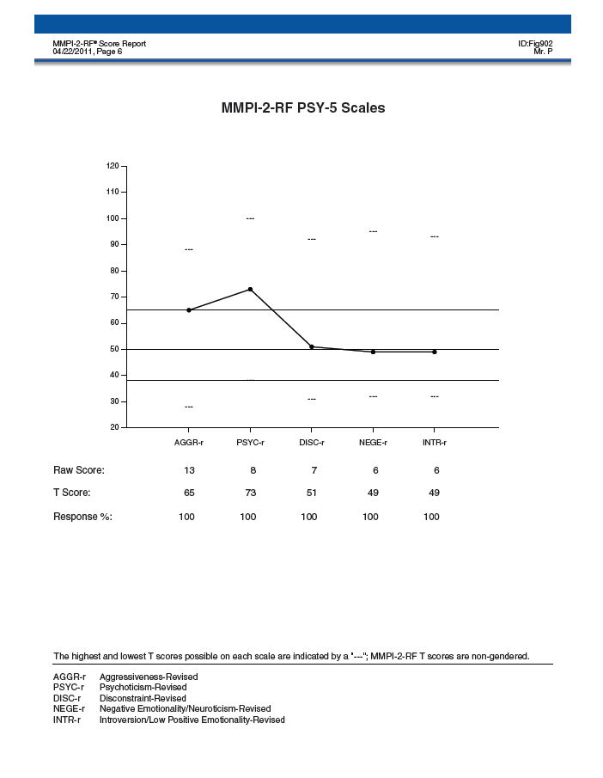

Slide 49
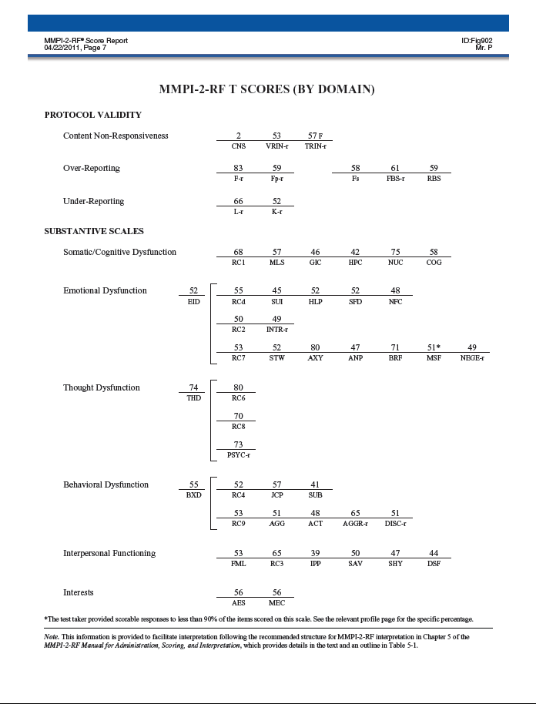

Slide 50
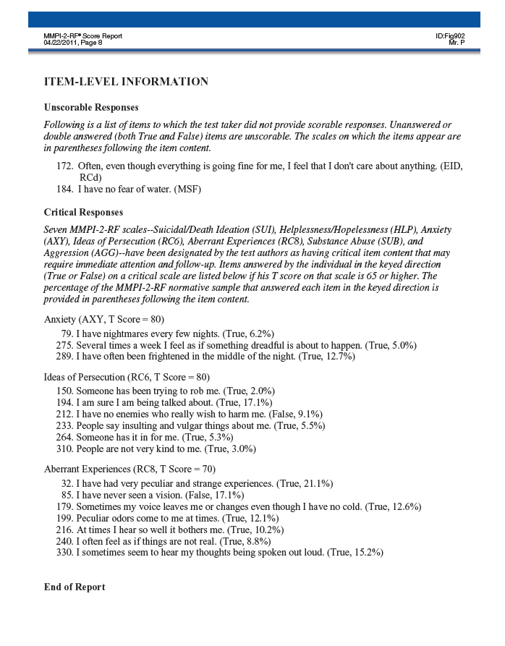

Slide 51
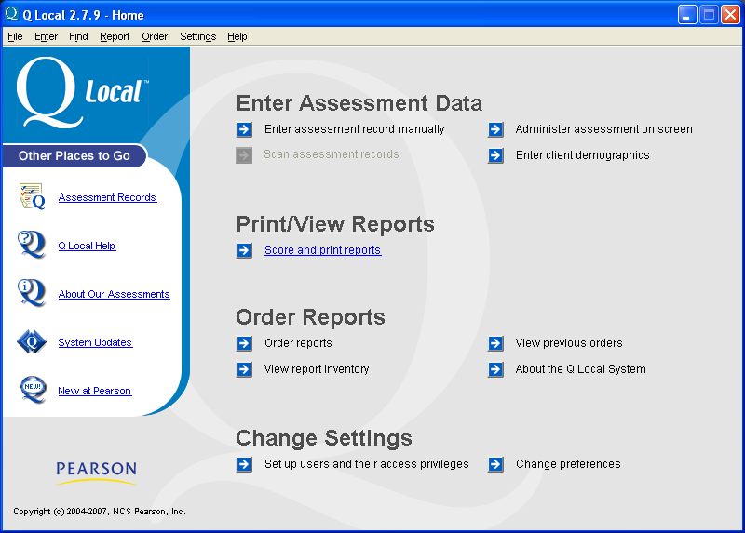

Slide 52
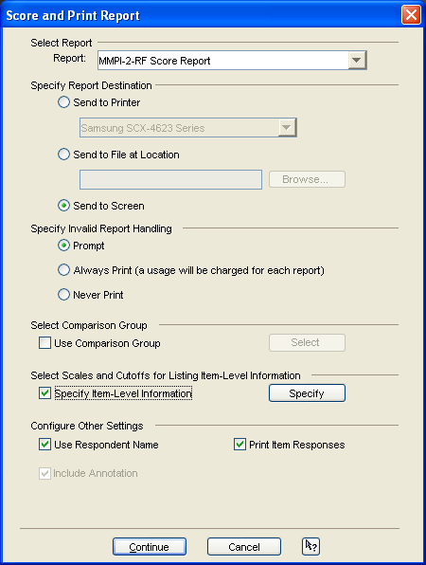

Slide 53
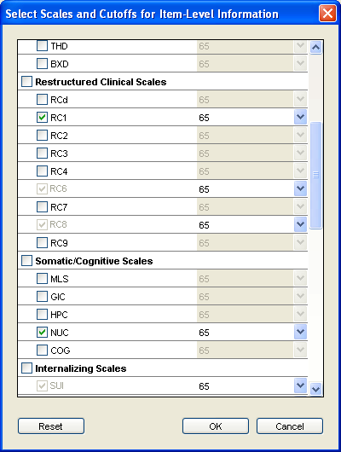

Slide 55
Administering and Scoring the MMPI-2-RF
Scoring:
Standard Scoring Modalities:
Hand scoring
Computer
Score Report (Q Local or Q Global)
Comparison Groups (Standard and Custom)

Slide 56
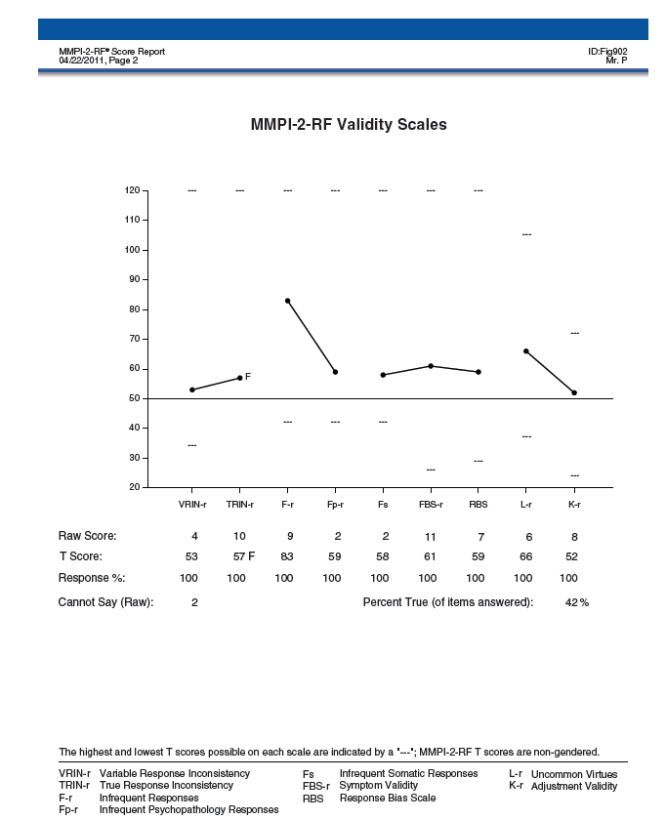

Slide 57
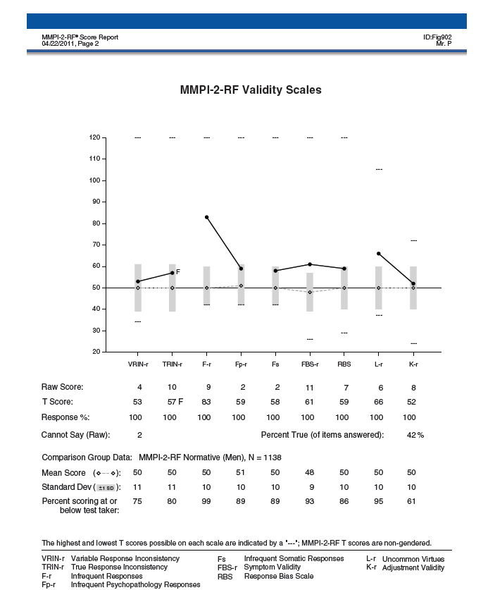

Slide 59
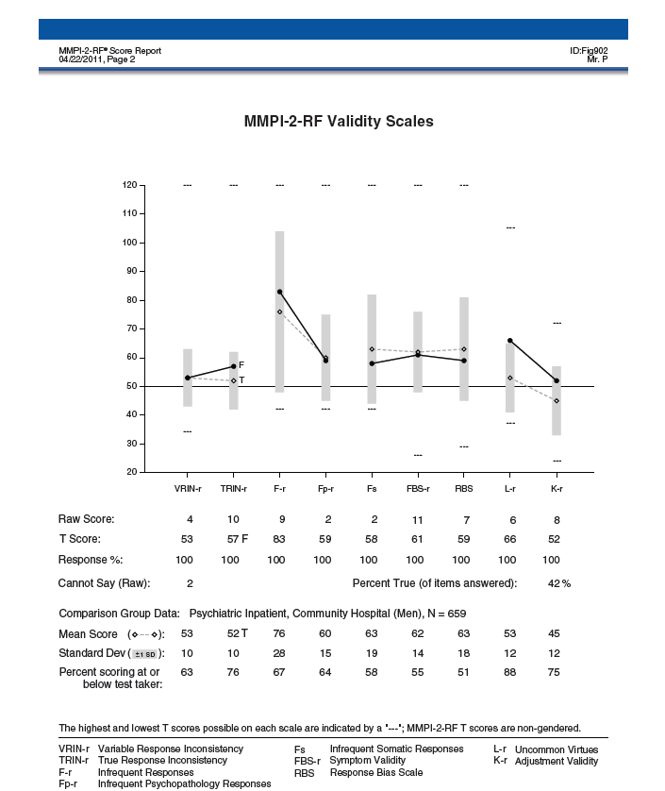

Slide 60
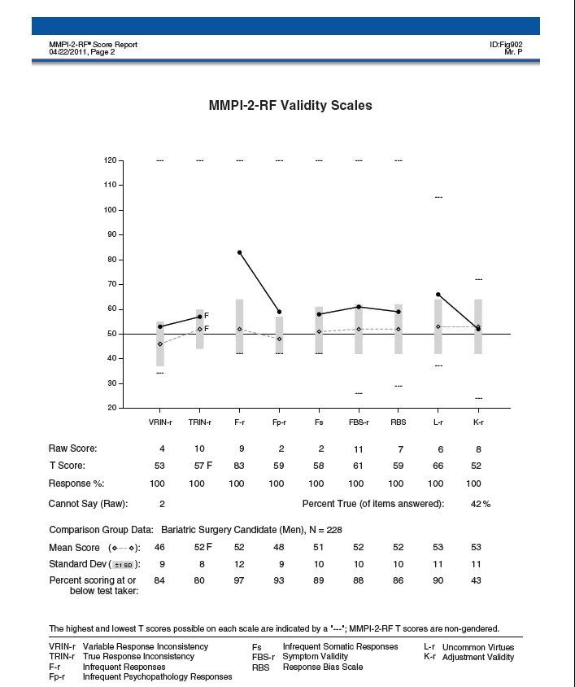

Slide 61
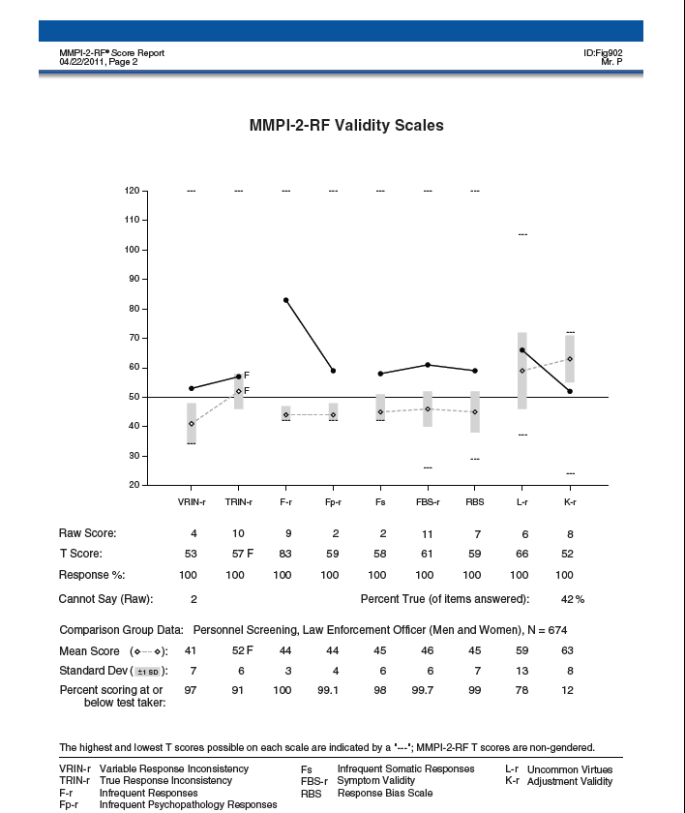

Slide 62
Custom Comparison Groups

Slide 63
Custom Comparison Groups
Provide the same information as standard comparison groups
Can be created for men, women, or combined gender
Require 200 valid MMPI-2-RF OR MMPI-2 cases stored on Q Local or Q Global

Slide 64
Administering and Scoring the MMPI-2-RF
Scoring:
Standard Scoring Modalities:
Hand scoring
Computer
Score Report
Comparison Groups (Standard and Custom)
Interpretive Report

Slide 65
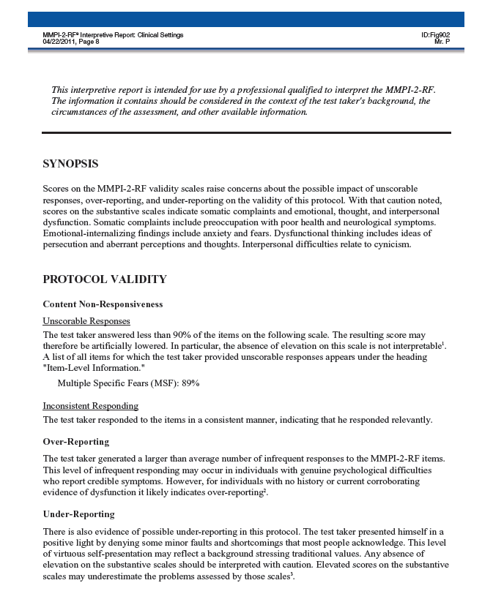

Slide 66
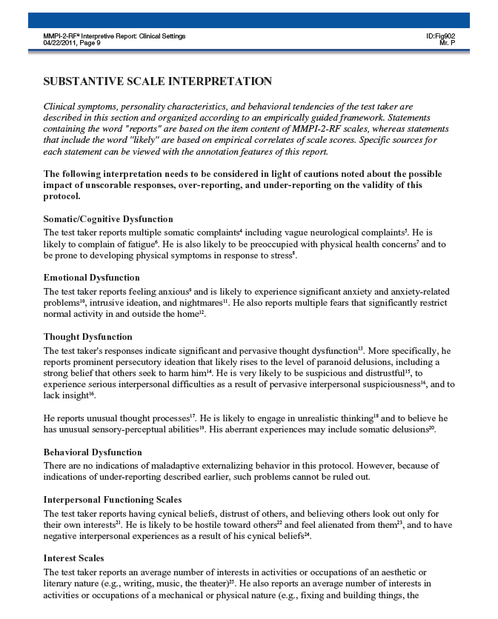

Slide 68
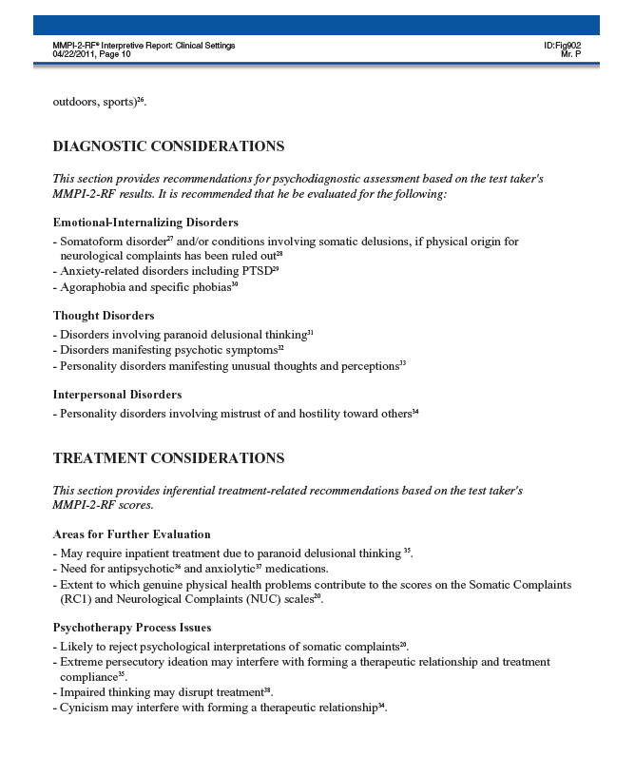

Slide 70
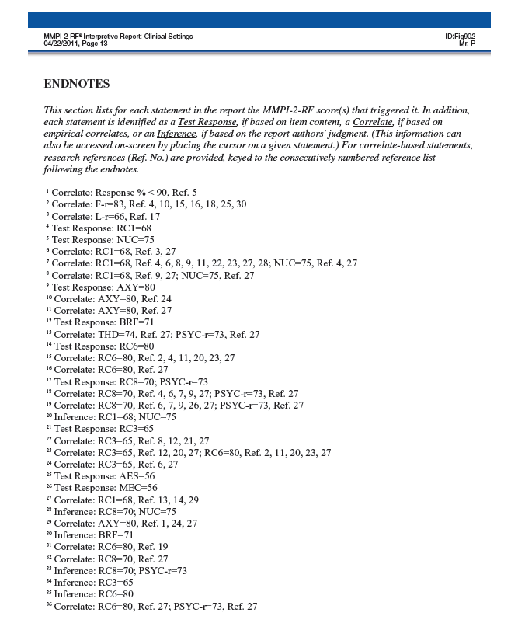

Slide 71
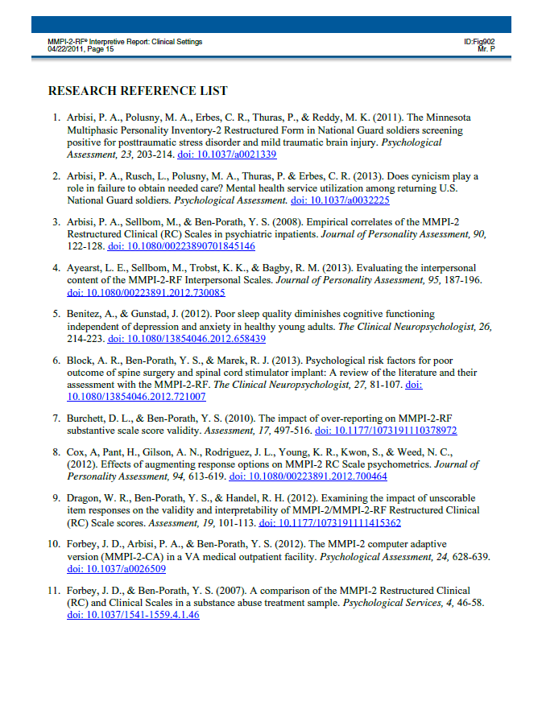

Slide 72
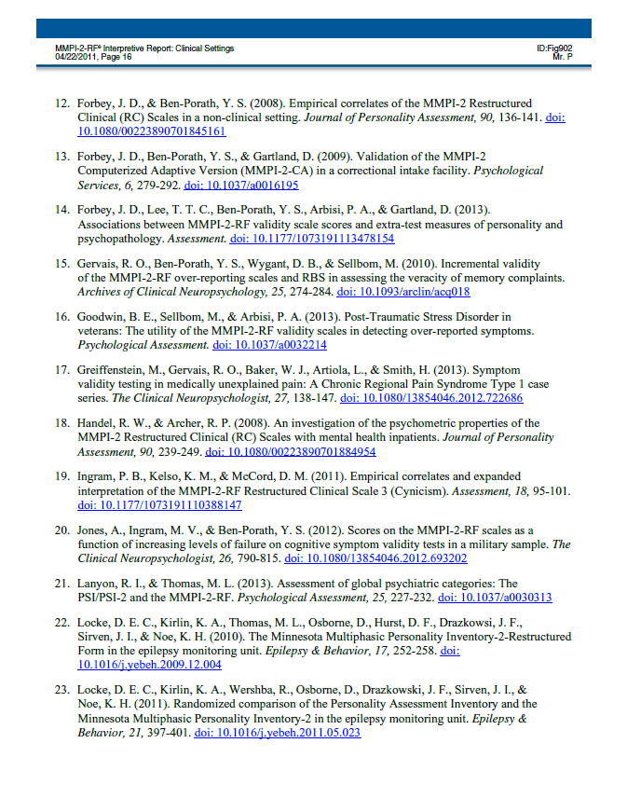

Slide 73
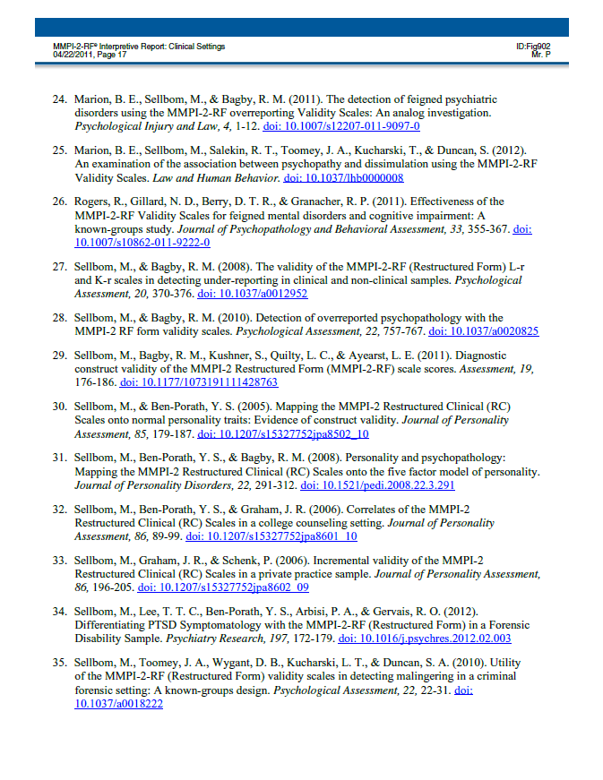

Slide 74
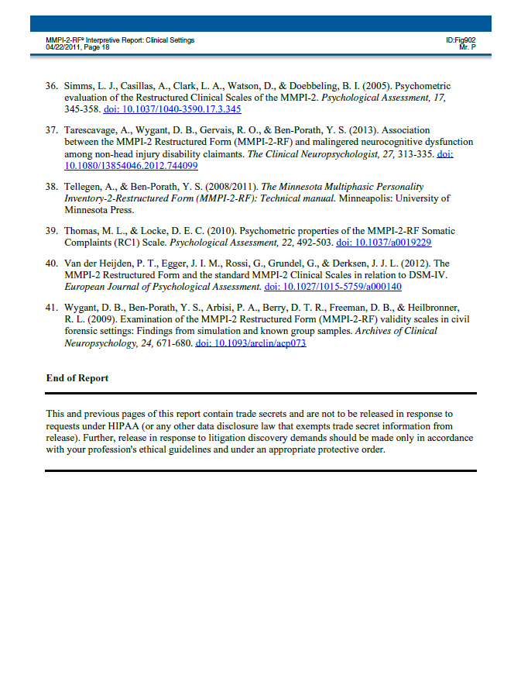

Slide 75
Interpreting the MMPI-2-RF

Slide 76
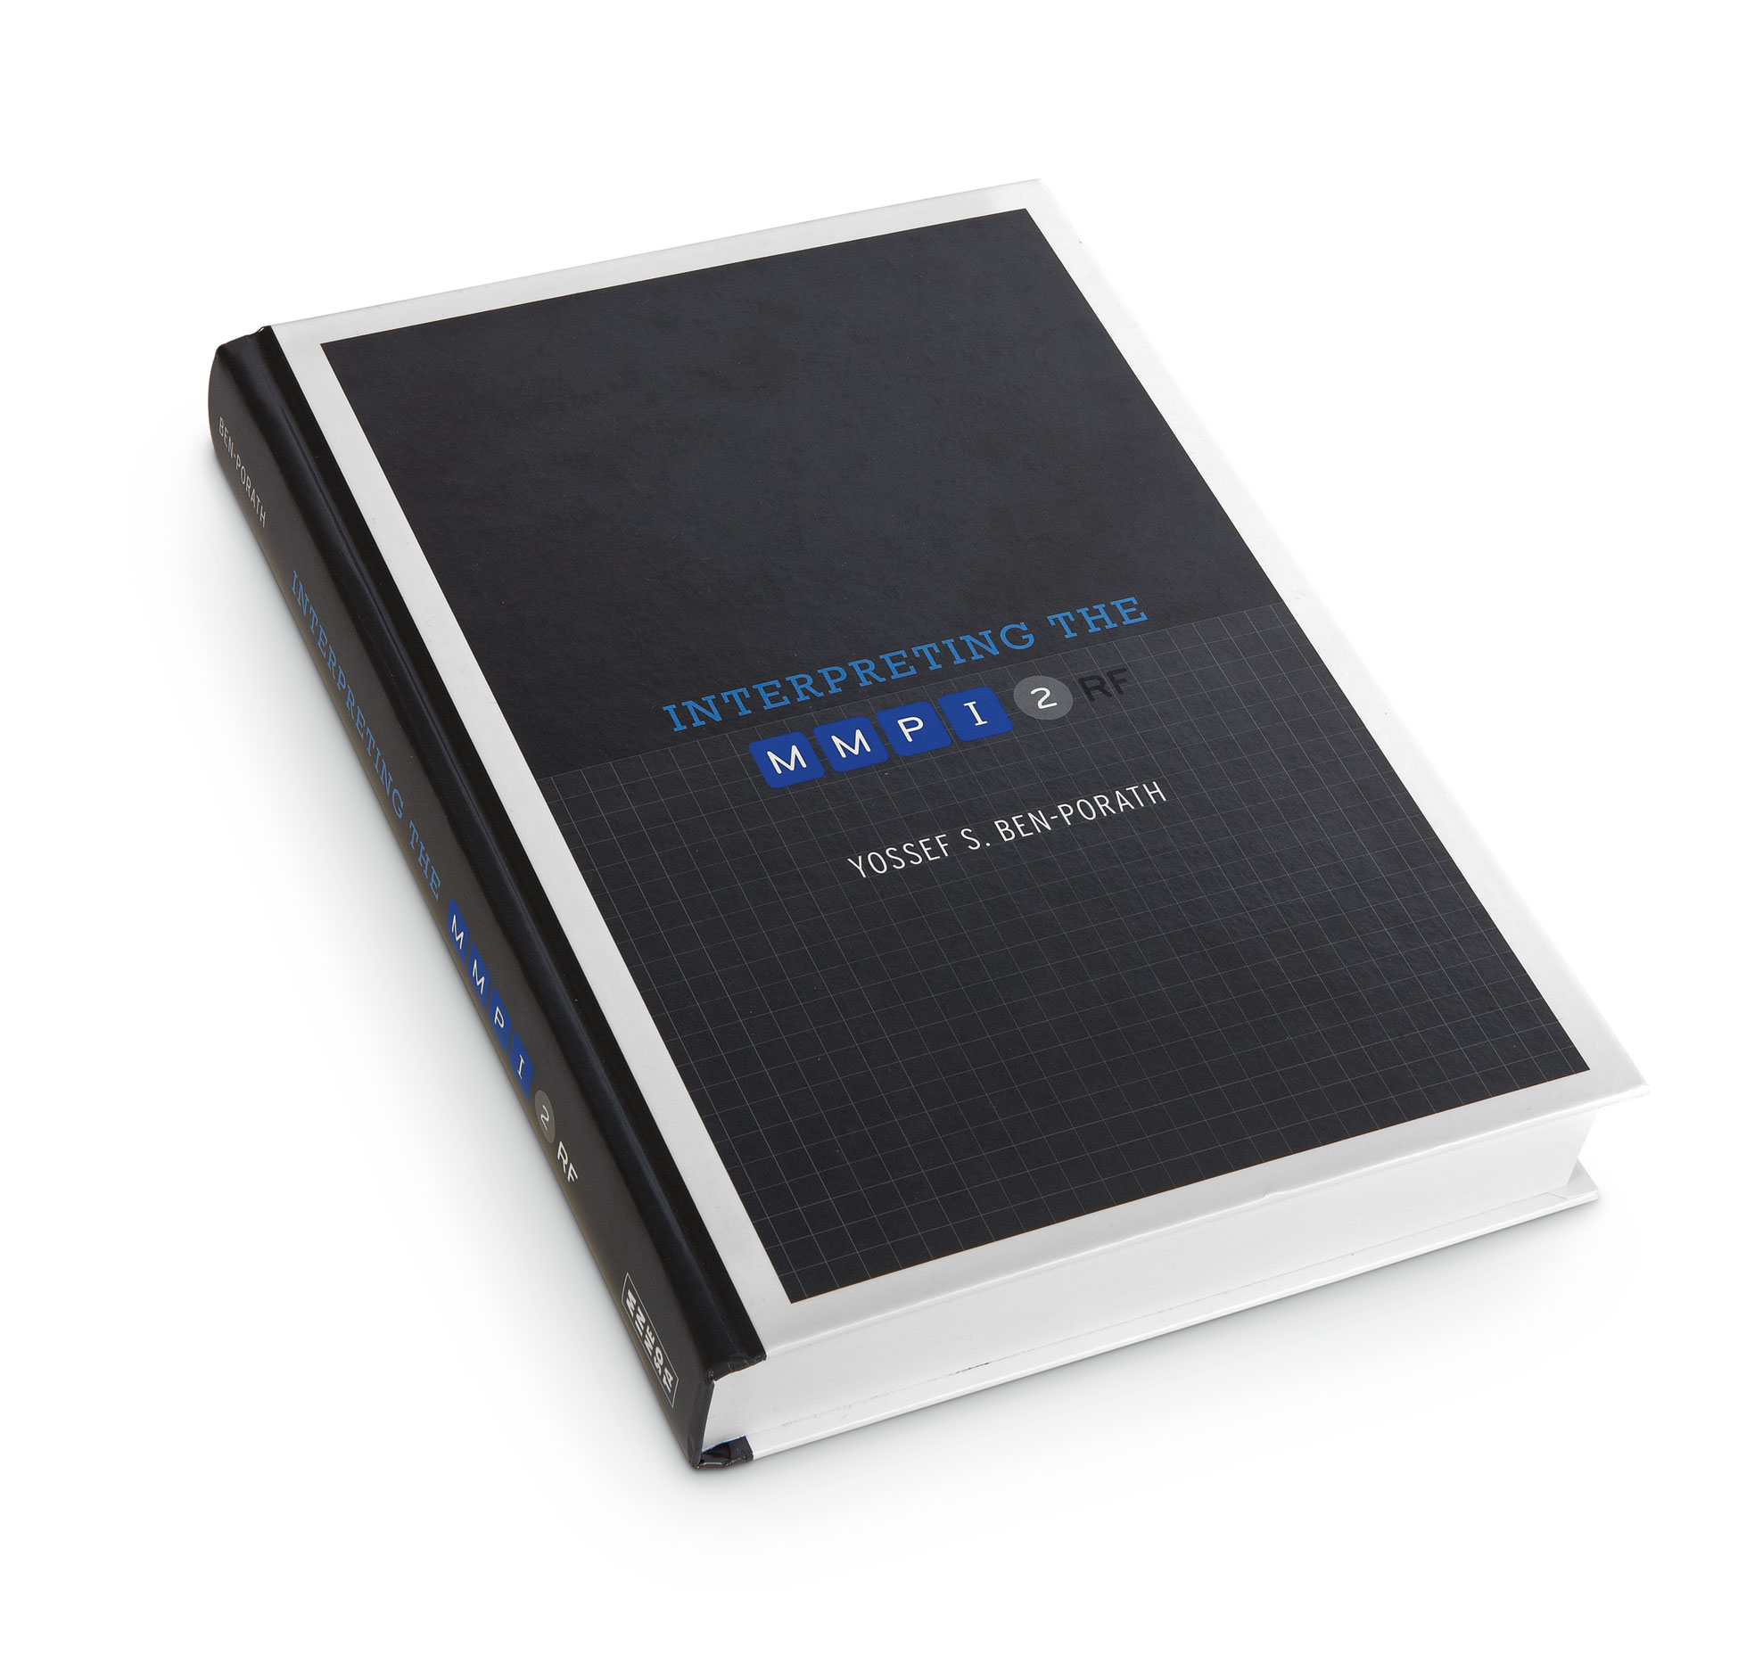

Slide 77
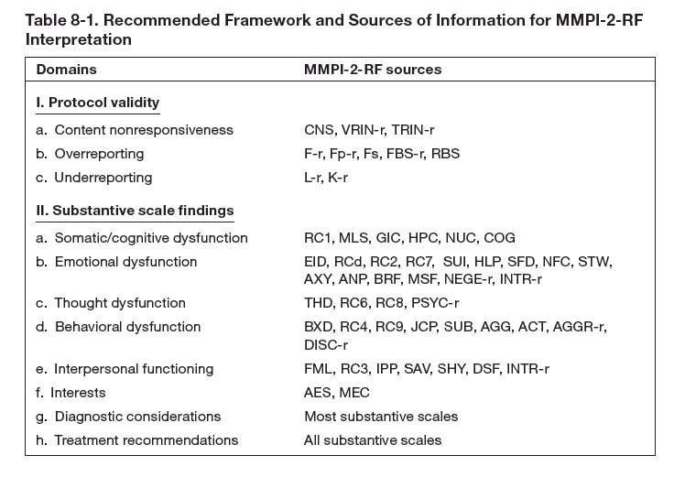

Slide 78
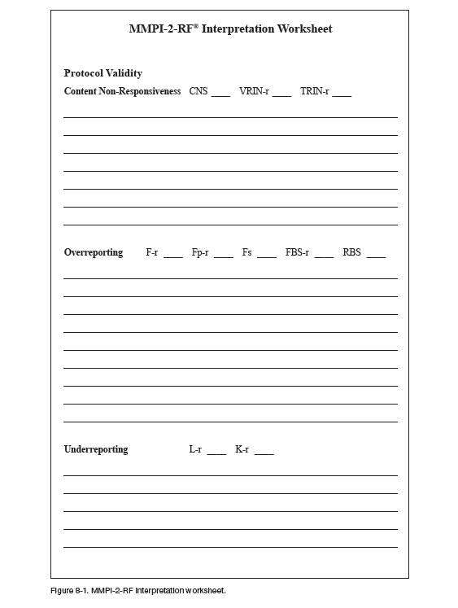

Slide 79
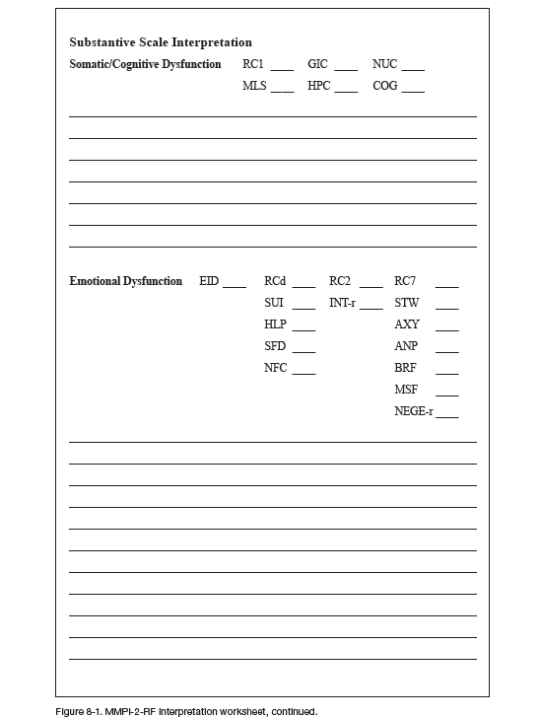

Slide 80
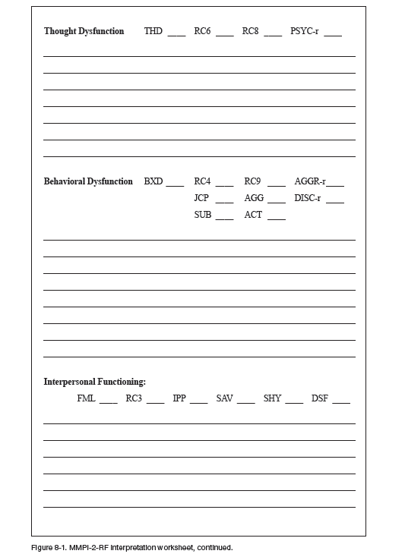

Slide 81
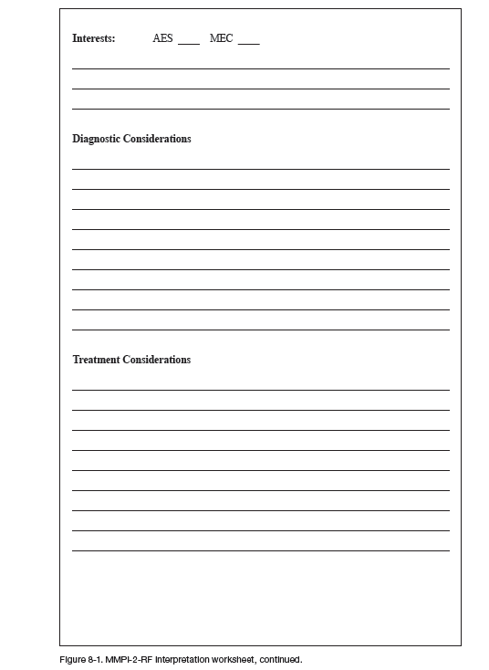

Slide 82
Threats to Protocol Validity
Threats to Protocol Validity
Non-Content-Based Invalid responding
Non-responding
Random responding
Fixed responding
Content-Based Invalid Responding
Over-reporting
Under-Reporting

Slide 83
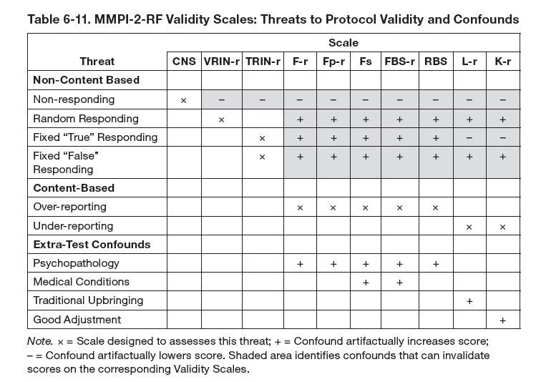

Slide 84
MMPI-2-RF Validity Scales
Content Non-Responsiveness
CNS
VRIN-r (Invalid if > 80)
TRIN-r (Invalid if > 80)
Over-Reporting
F-r (Invalid if = 120)
Fp-r (Invalid if > 100)
Fs
FBS-r
RBS
Under-Reporting
L-r
K-r

Slide 85
MMPI-2-RF Interpretation
Substantive Scale Interpretation
Begin with Higher-Order Scales
If only one is elevated, use it as starting point then interpret all RC, Specific Problems, PSY-5 scales in that area
When interpreting RC Scales:
proceed in order of elevation
incorporate relevant SP Scales and PSY-5

Slide 87
MMPI-2-RF Interpretation
Substantive Scale Interpretation
Begin with Higher-Order Scales
If only one is elevated, use it as starting point then interpret all RC, Specific Problems, PSY-5 scales in that area
When interpreting RC Scales:
proceed in order of elevation
incorporate relevant SP Scales and PSY-5
If more than one H-O Scale is elevated, use highest as starting point, then proceed to next highest
If no H-O Scale is elevated, proceed to RC Scales and interpret by domain, in order of elevation, incorporating relevant SP and PSY-5 scales

Slide 88
MMPI-2-RF Interpretation
Substantive Scale Interpretation
Once all H-O and RC Scales are covered:
Interpret any remaining elevated SP Scales
Interpret Interpersonal and Interest scales
If relevant, add diagnostic and treatment considerations along the way

Slide 90
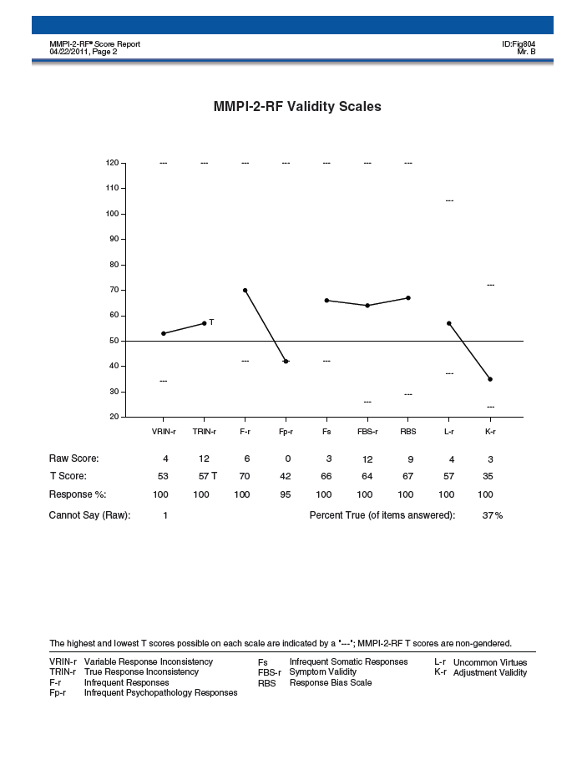

Slide 91
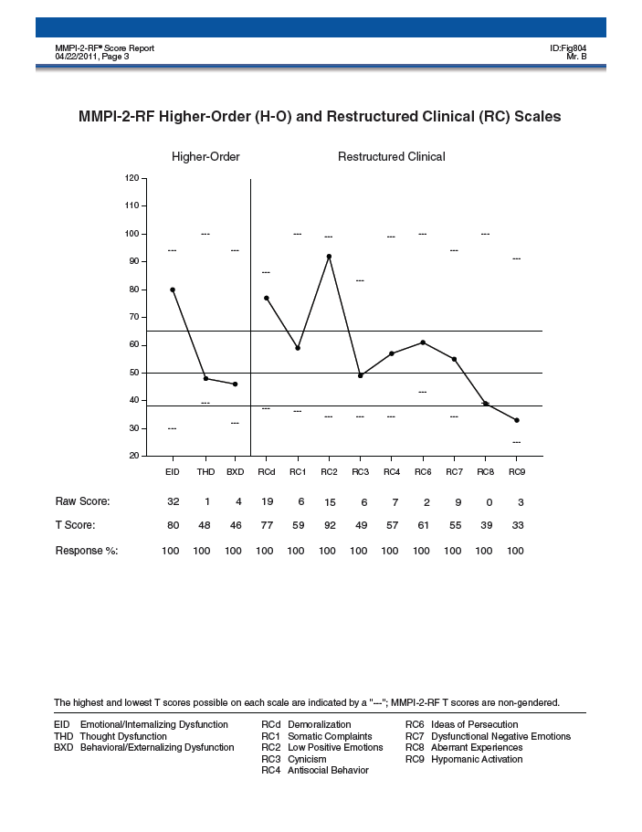

Slide 92
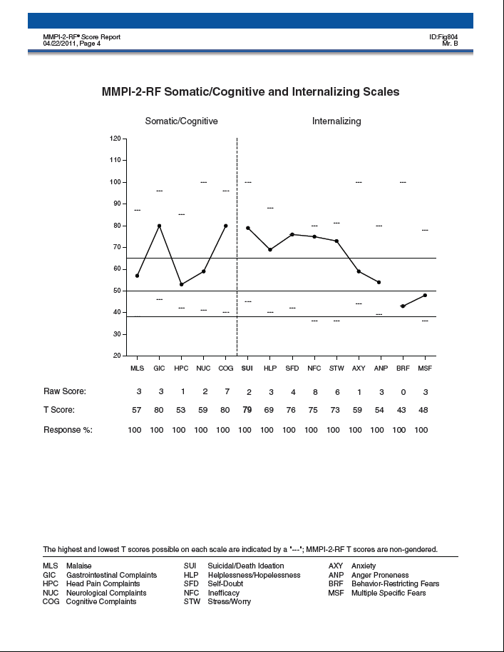

Slide 93
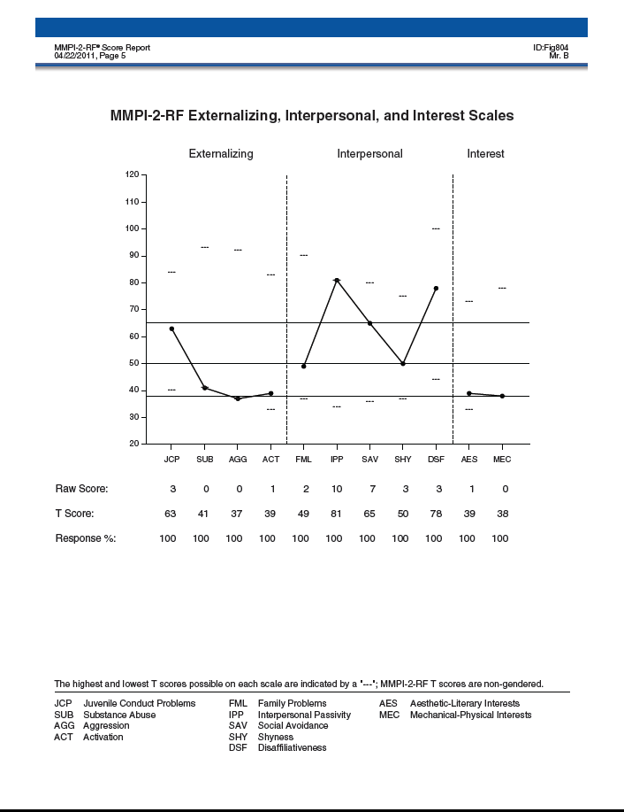

Slide 94
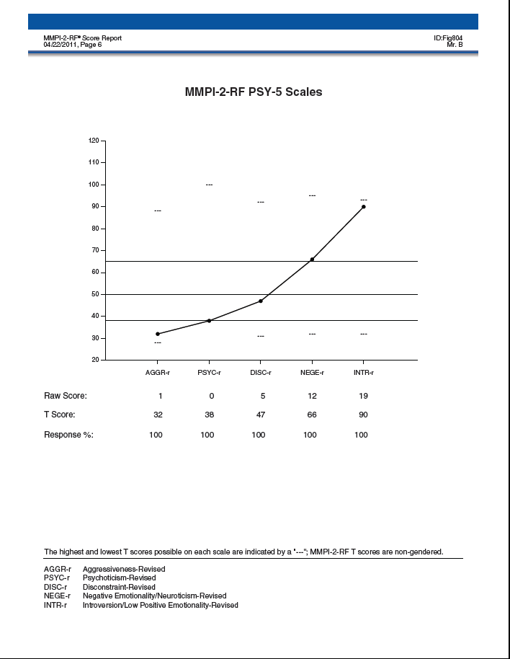

Slide 95
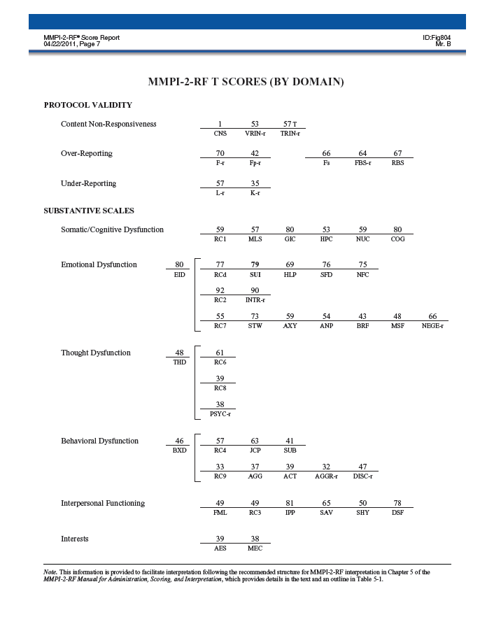

Slide 97
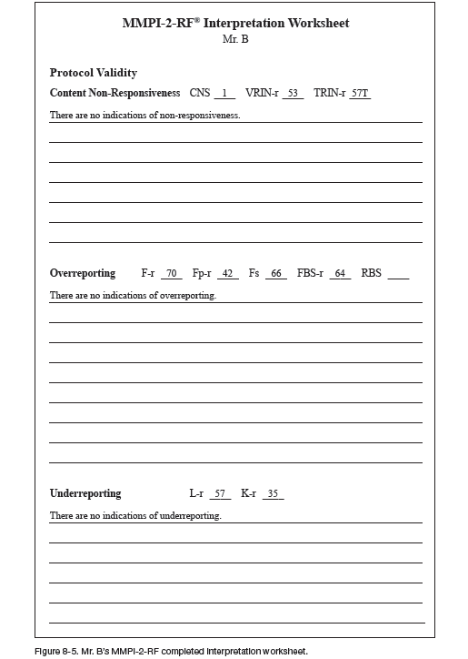

Slide 98
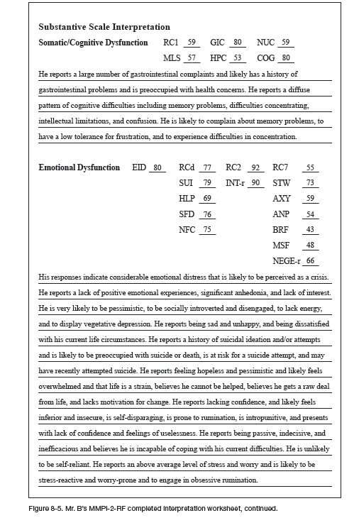

Slide 99
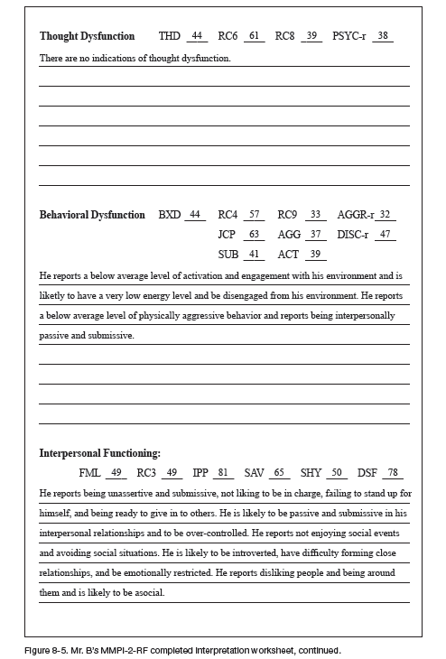

Slide 101
Cases

Slide 102
Ms. G
35 year old single woman
Self-referred to community mental health center
Recent job loss owing to obsessive-compulsive behavior
Preoccupied with worry that apartment will catch fire or be burglarized
Repeated checking that stove pilot light on, appliances turned off, apartment door locked
Increasing intensity of checking behavior leads to frequent tardiness, reduced productivity, and termination

Slide 103
Ms. G
No prior involvement with mental health system
Family of origin intact with no reported abuse
Long-term romantic relationship ended at time that her symptoms became more severe
First time living on own
At intake, reported feeling anxious, depressed, embarrassed, and guilty over job loss
Diagnosed provisionally with OCD

Slide 121
Mr. P
49 year old, single male
Long-standing Dx of Schizophrenia, Paranoid type
Diagnosed late teens; resides with parents throughout adult life
Father passed away when Mr. P was in his 20s
Mother now in 70s
Received case management services in community
Periodic employment as unskilled laborer under auspices of CMHC

Slide 122
Mr. P
Several weeks prior to hospitalization Mr. P became embroiled in conflict with co-worker
Employment suspended as a consequence of physical altercation
Discontinued medication and decompensated into acute psychotic episode marked by belief that job loss is the result of gov’t conspiracy to take away his disability benefits as well
Mother informed case worker that Mr. P was threatening retaliation against co-worker
Although no history of violent behavior, psychiatrist determined significant risk

Slide 132
Mr. E
28 year old, never married, male
Arrested after assaulting stranger in a bar
Arresting officer noted mumbling incoherently, religiously preoccupied
Taken to crisis united; observed to be intoxicated, but possibly also psychotic
Admitted to psychiatric community hospital inpatient unit
Tested after three days

